Slide 1
Understanding Factors in Animal Shelter Adoption
Presented By: Erik Enriquez

Slide 2
Overview
Introduction and Background
Exploratory Data Analysis
Classification Models
Binomial Models (Home Found vs. No Home Found)
Multinomial Classification Models (Outcome Type)
Summary and Conclusions
Future Work

Slide 3
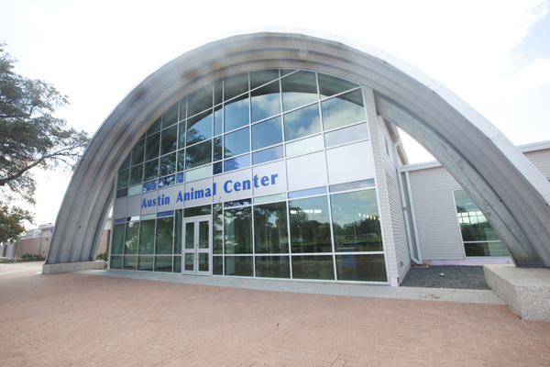
Introduction
Introduction
EDA
Classification Models
Summary
Future Work
Austin Animal Center
Austin Animal Center provides data on their shelter performance
Motivation: Find ways to improve center performance and understand the factors that influence pet adoption outcomes to suggest practices that can inform additional shelters

Slide 4
Introduction
EDA
EDA
Classification Models
Summary
Future Work
Outcome vs. Animal Attributes

Slide 5
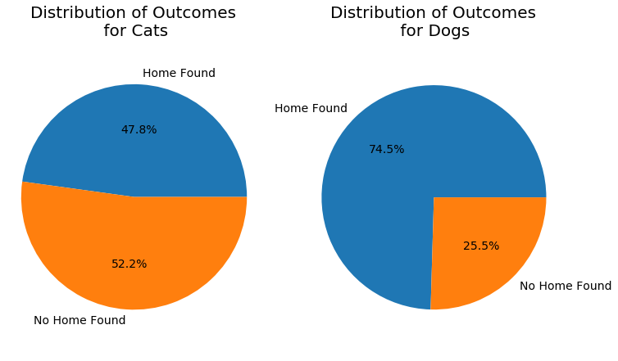
Introduction
EDA
EDA
Classification Models
Summary
Future Work
Cats vs. Dogs

Slide 6
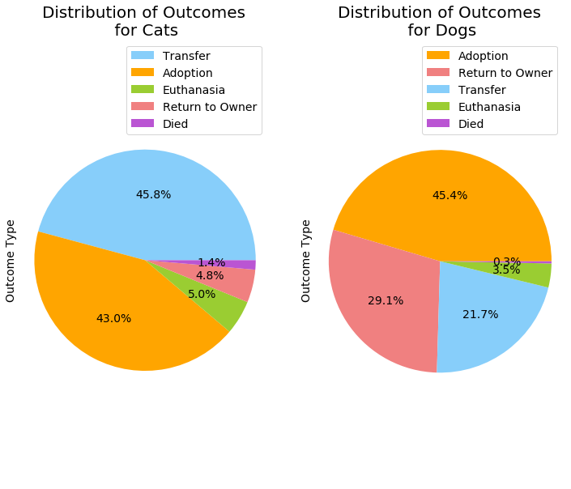
Introduction
EDA
EDA
Classification Models
Summary
Future Work
Cats vs. Dogs – Specific Outcomes

Slide 7
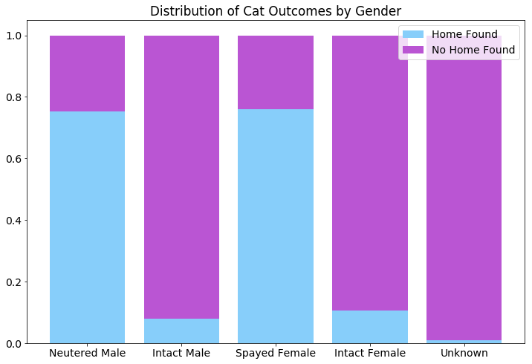
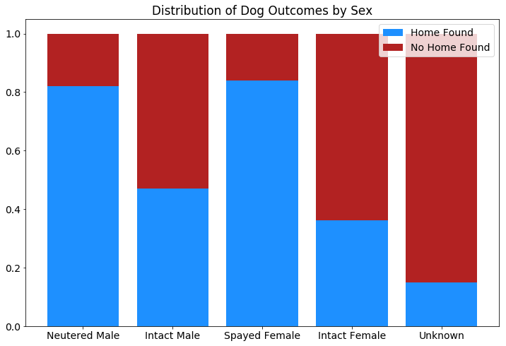
Introduction
EDA
EDA
Classification Models
Summary
Future Work
Influence of Gender
Although the distribution is highly skewed in favor of spayed and neutered animals, this is understandable since shelters usually spay and neuter their incoming animals

Slide 8
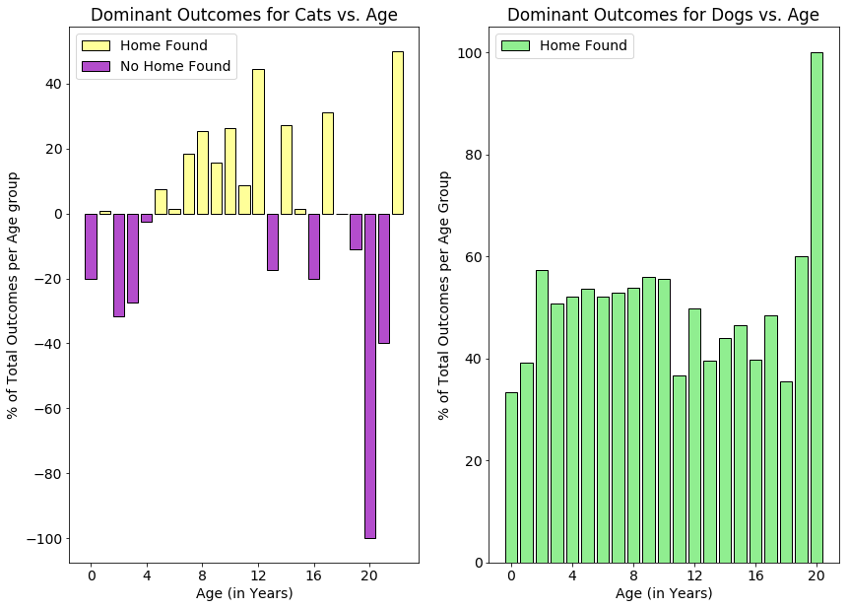
Introduction
EDA
EDA
Classification Models
Summary
Future Work
Influence of Age
While dogs of all ages have a higher chance of finding a home than not, very young and very old cats are shown to have some trouble.

Slide 9
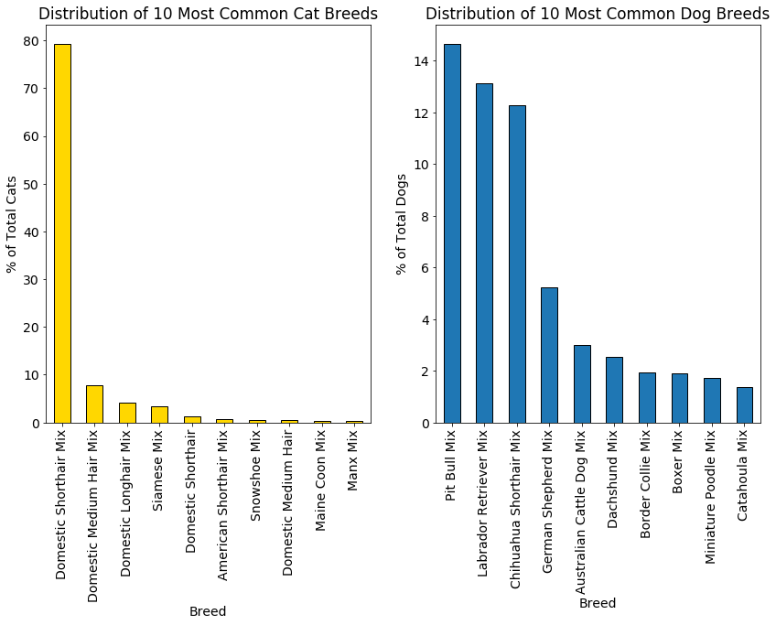
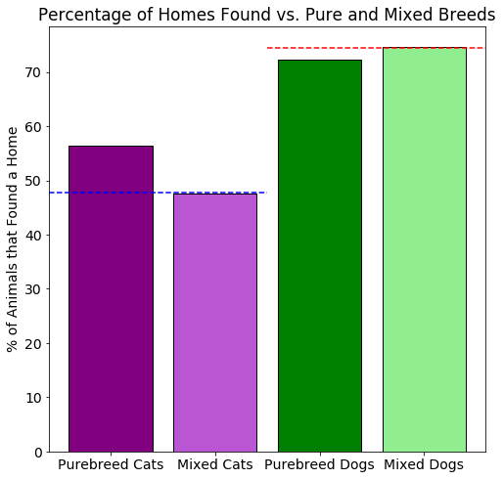
Introduction
EDA
EDA
Classification Models
Summary
Future Work
Influence of Breed
Dogs have a much wider breed distribution than cats, which are dominated by Domestic Shorthair mixed breed.

Slide 10
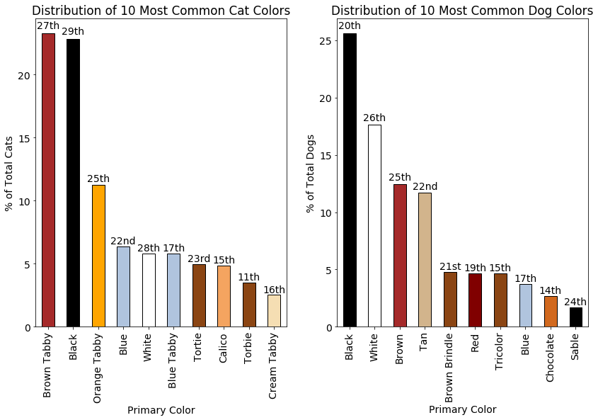
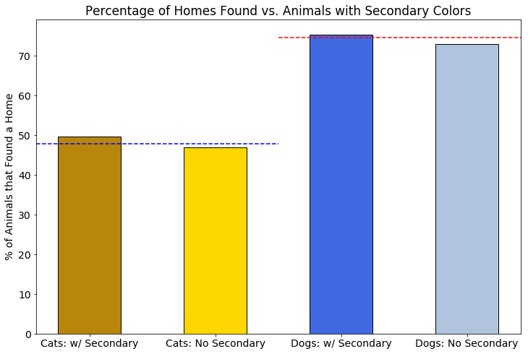
Introduction
EDA
EDA
Classification Models
Summary
Future Work
Influence of Color
Ranking of most frequently adopted is displayed above the bars.
None of the most common cat or dog colors appear in the top 10 breeds most likely to find a home.

Slide 11
Introduction
EDA
EDA
Classification Models
Summary
Future Work
Outcomes vs. Time

Slide 12
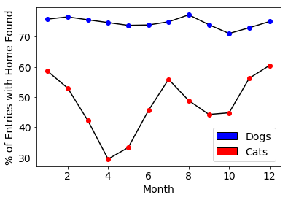
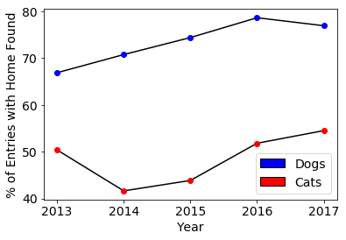
Introduction
EDA
EDA
Classification Models
Summary
Future Work
While outcomes for dogs are relatively stable, outcomes for cats varies highly with drops in spring and fall months
Overall, the performance of the center is shown to be improving with time
Homes Found vs. Month
Homes Found vs. Year

Slide 13
Introduction
EDA
Classification Models
Classification Models
Summary
Future Work
Binomial Classification Models

Slide 14
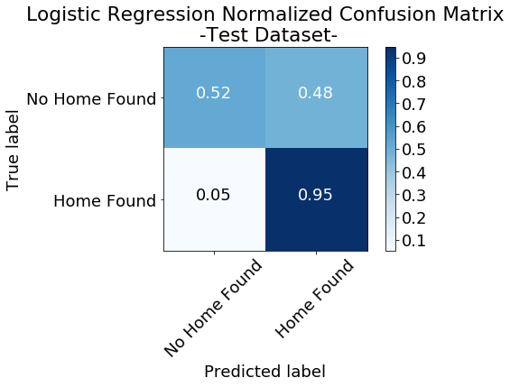
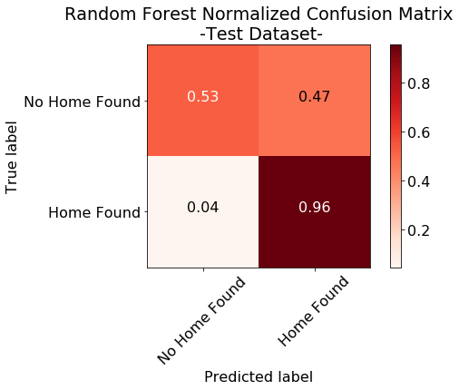
Introduction
EDA
Classification Models
Classification Models
Summary
Future Work
Confusion Matrix Accuracy of Models
The models have similar performance, and have trouble correctly classifying the negative outcomes

Slide 15
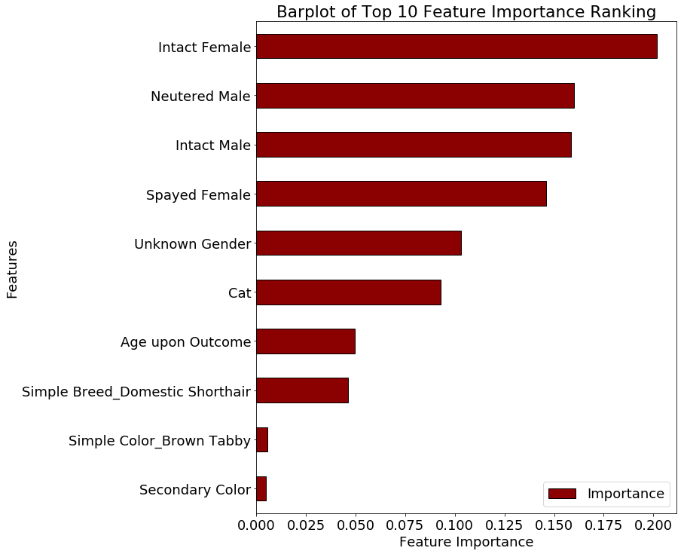
Introduction
EDA
Classification Models
Classification Models
Summary
Future Work
Feature Importance
Top features as ranked by random forest algorithm
Gender, animal type and age seem to play a large role

Slide 16
Introduction
EDA
Classification Models
Classification Models
Summary
Future Work
Multinomial Classification Models

Slide 17
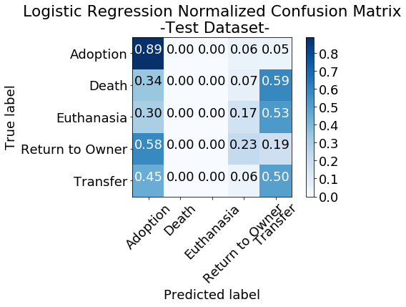
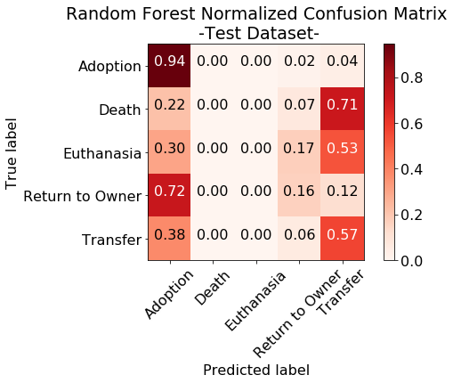
Introduction
EDA
Classification Models
Classification Models
Summary
Future Work
Multinomial Confusion Matrix Metric
Both algorithms have trouble classifying the marginal classes
Otherwise, performance is again similar between the models

Slide 18
Introduction
EDA
Classification Models
Classification Models
Summary
Future Work
Further Optimization

Slide 19
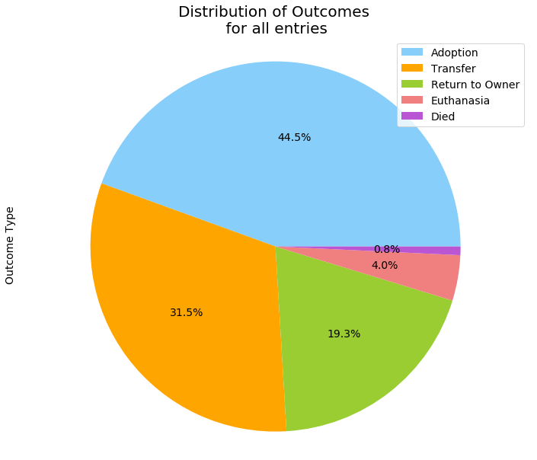
Introduction
EDA
Classification Models
Classification Models
Summary
Future Work
Adjusting Class Weights by Distribution
In order to optimize, we can adjust the class weights in the model
Smaller classes such as Return to Owner, Euthanasia and Death are given higher weights inversely proportional to the fraction of outcomes they occupy

Slide 20
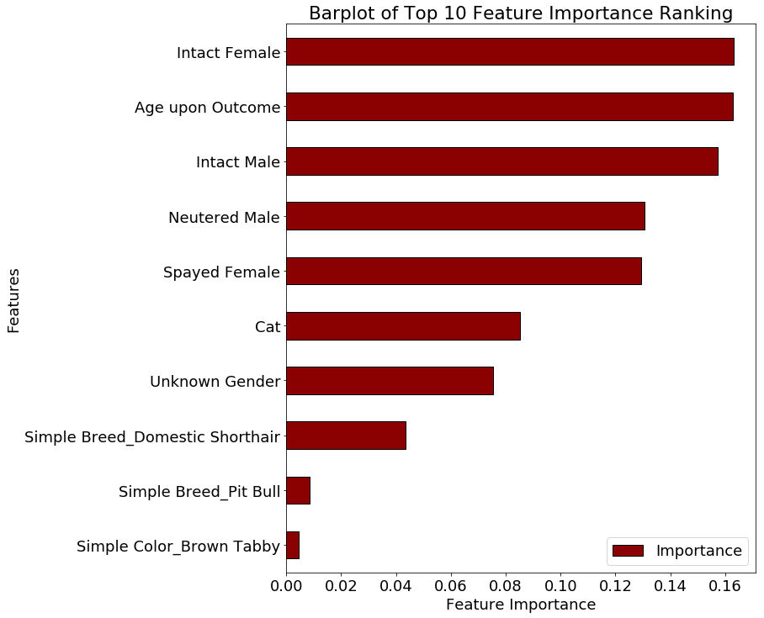
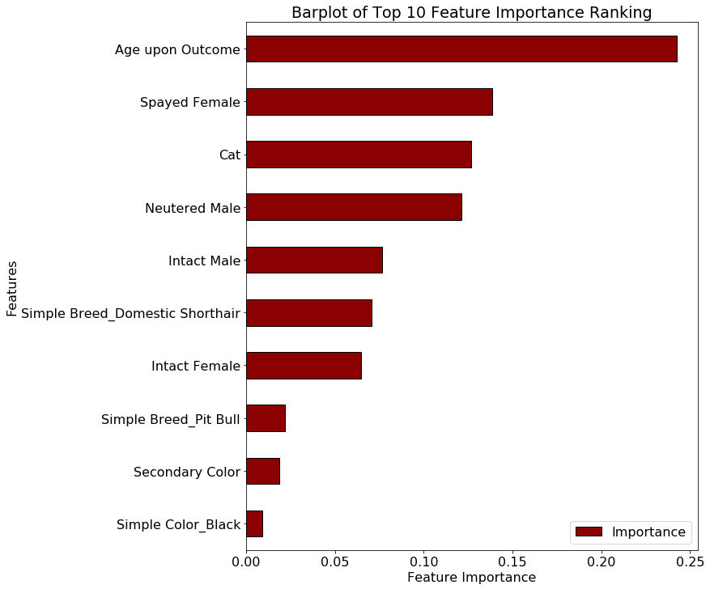
Introduction
EDA
Classification Models
Classification Models
Summary
Future Work
Before Class
Weight Adjustment
After Class
Weight Adjustment

Slide 21
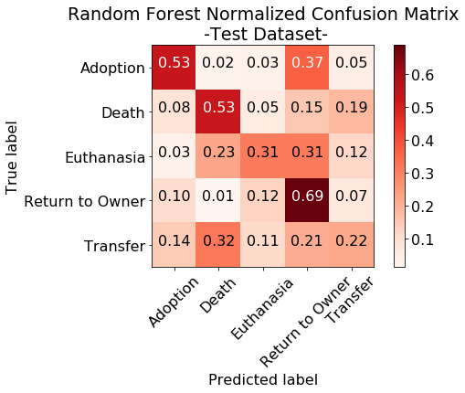
Introduction
EDA
Classification Models
Classification Models
Summary
Future Work
Before Class
Weight Adjustment
After Class
Weight Adjustment

Slide 22
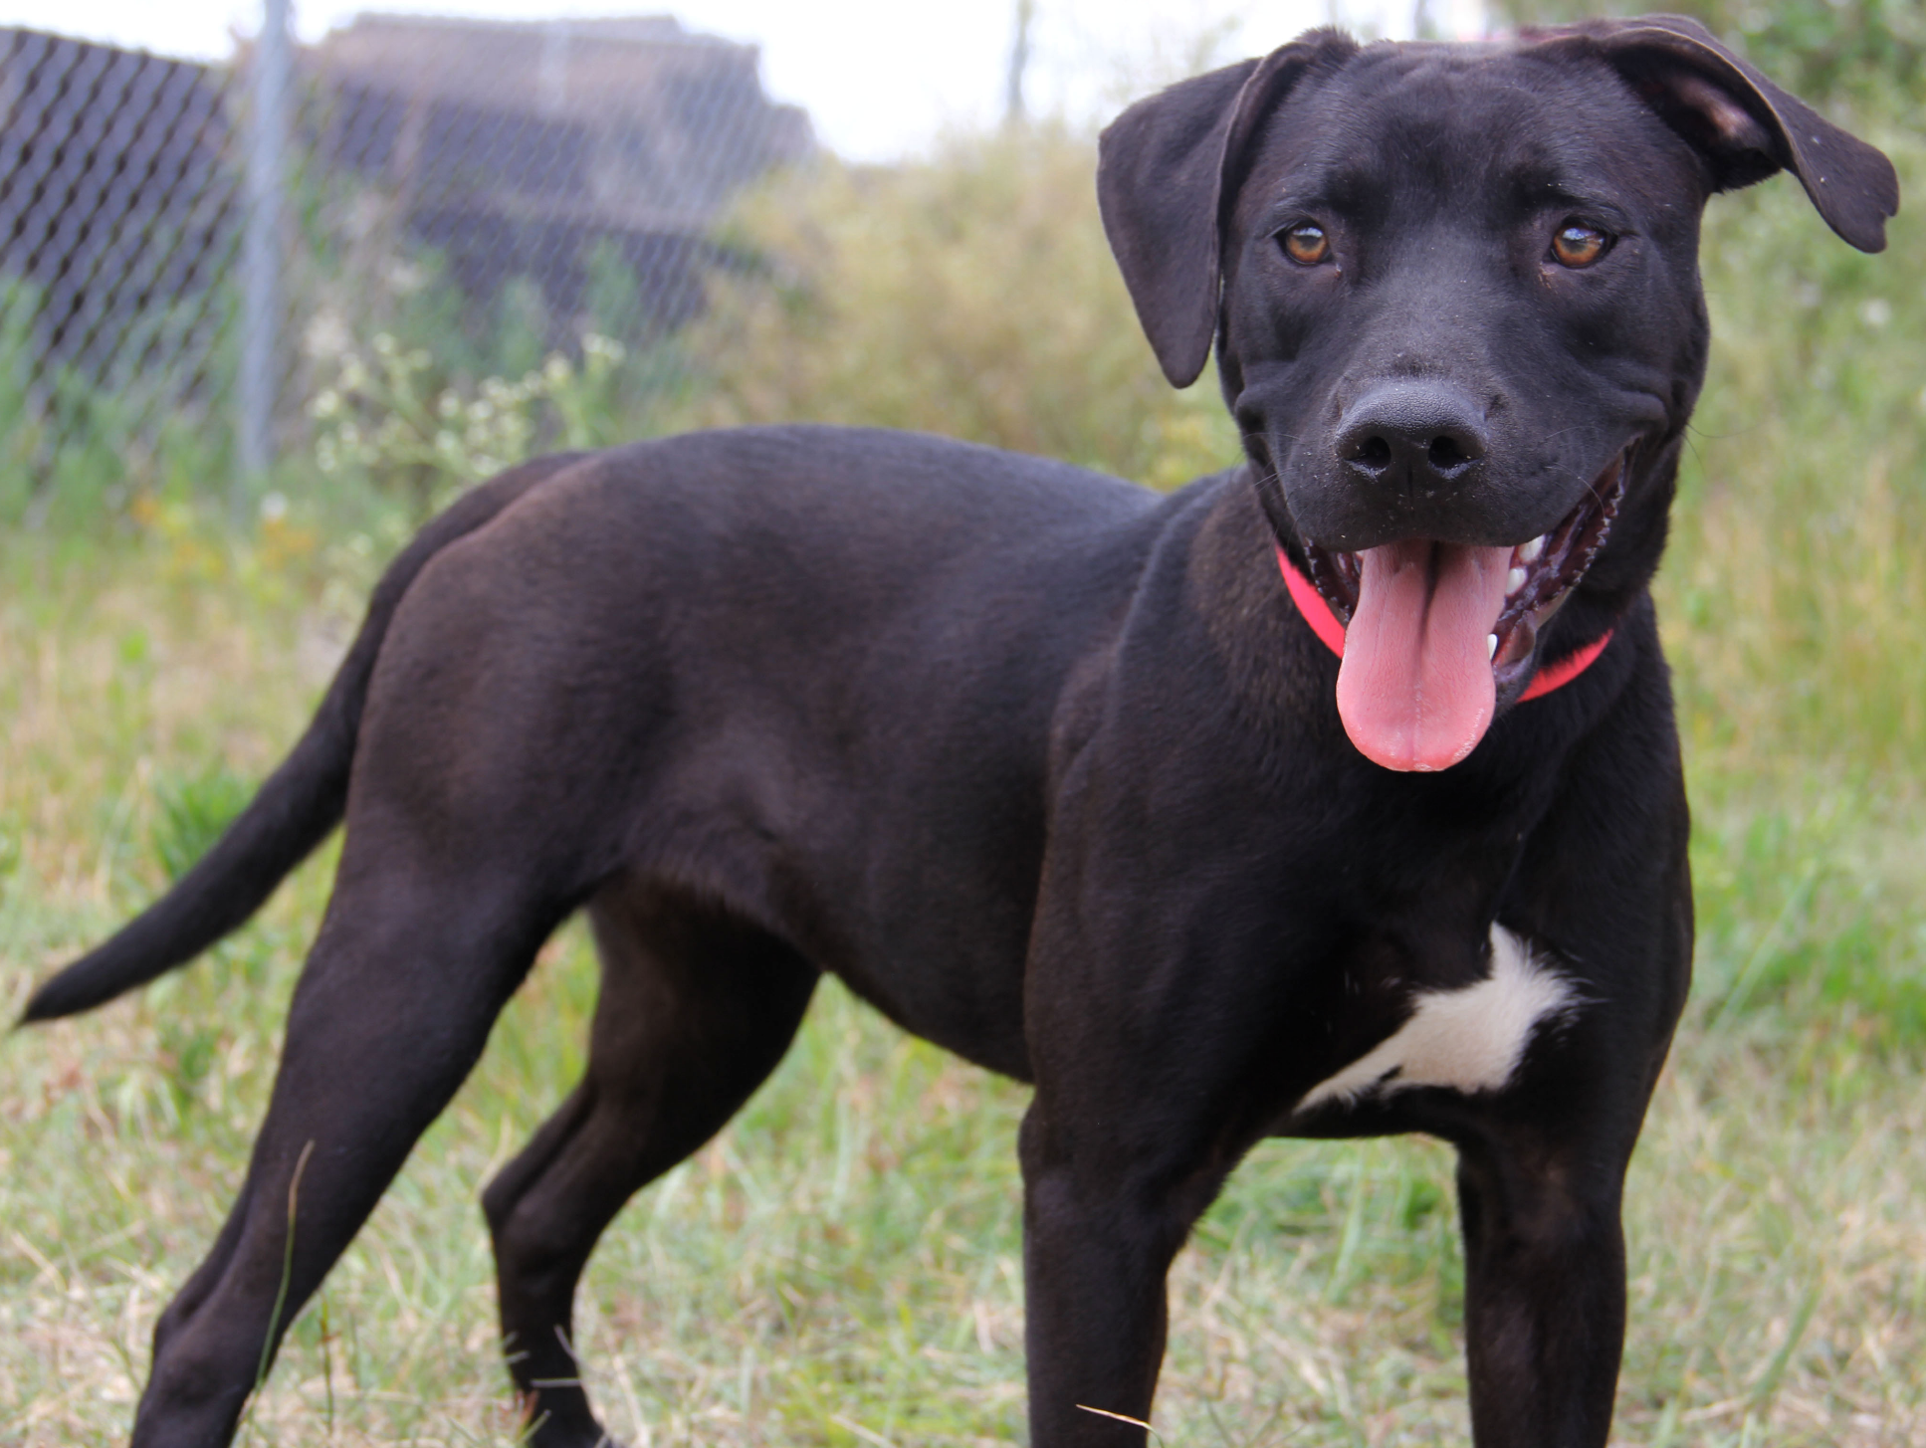
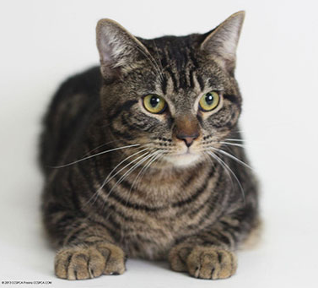
Introduction
EDA
Classification Models
Summary
Summary
Future Work
Conclusions
We learned via our analysis that the cats and dogs that seem to have the most trouble finding a home are those that are the most common. Visually distinctive animals may have a better chance of catching the attention of potential adopters.
Actionable Recommendations:
Give more publicity to most common animals on social media/center websites
Via the “Mere Exposure Effect”, publicity for more common animals may appeal to more people before they even arrive at the center seeking animals for adoption

Slide 23
Introduction
EDA
Classification Models
Summary
Future Work
Future Work
Improve models by optimizing performance via fine adjustments in class weights
Improve feature engineering/selection for higher quality input of data based on previous results
Optimize regularization parameters to find sufficiently complex models without overfitting the data

Slide 24
Thank you!
Thanks to Springboard team for providing curriculum and continued support
Special thanks to Alex Rutherford for guidance and mentorship on this project

Slide 25
Additional Resources
Dataset – City of Austin – Open Data Portal
Austin Animal Center – Website
Facebook Page
Project Proposal - github
Code (IPython Notebooks):
Data Cleaning – github
Data Exploration – github
Classification Models - github

